Slide 1
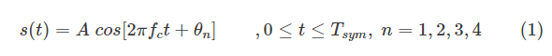

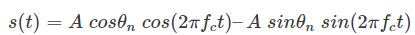
Quadrature Phase Shift Keying (QPSK)
QPSK is a form of phase modulation technique, in which two information bits (combined as one symbol) are modulated at once, selecting one of the four possible carrier phase shift states. The QPSK signal within a symbol duration is defined as,
where the signal phase is given by,
Therefore, the four possible initial signal phases are π/4, 3π/4, 5π/4 and 7π/4 radians. Equation (1) can be re-written as,

Slide 2
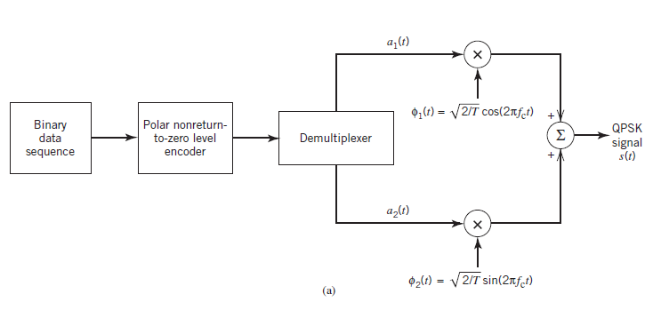
QPSK Modulation

Slide 3
Continuation…
Polar NRZ-level encoder, which represents symbols 1 and 0 of the incoming binary sequence by positive and negative amplitude levels respectively.
The function of the demultiplexer is to divide the binary wave produced by the polar NRZ-level encoder into two separate binary waves, one of which represents the odd-numbered dibits and the other represents the even-numbered dibits in the incoming binary sequence.
Product modulator, which multiplies the output of the demultiplexer by the basis function which acts as the “carrier” for PSK signal.
Finally, both the outputs from product modulators are summed to produce the required QPSK Signal.

Slide 4
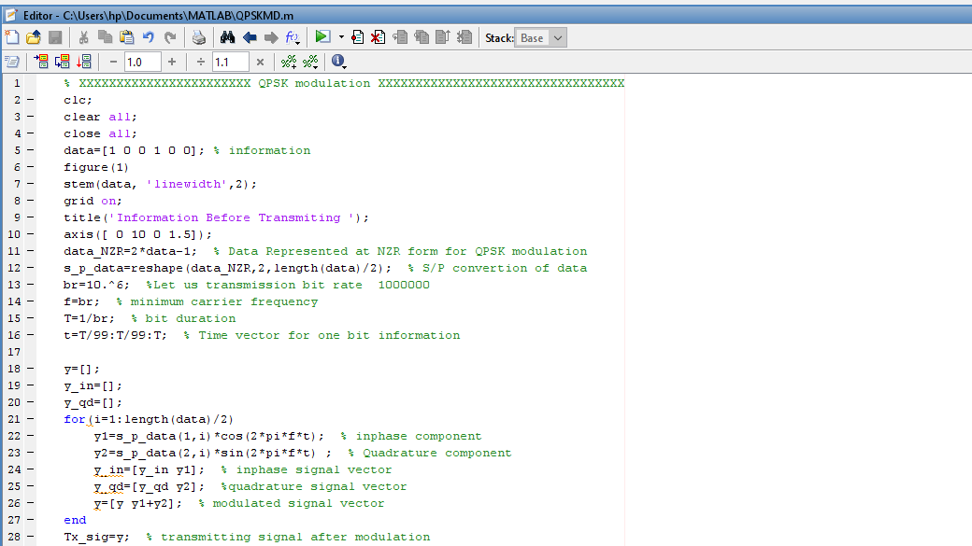

Slide 5
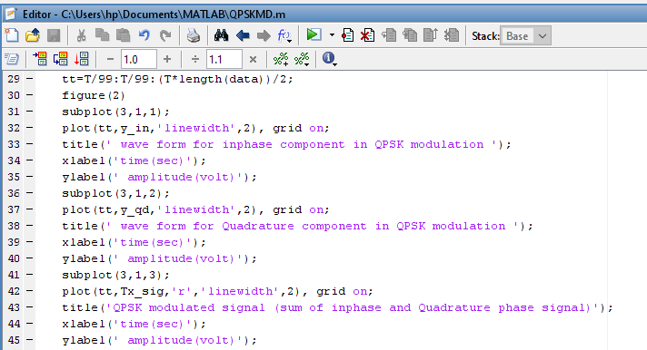

Slide 6
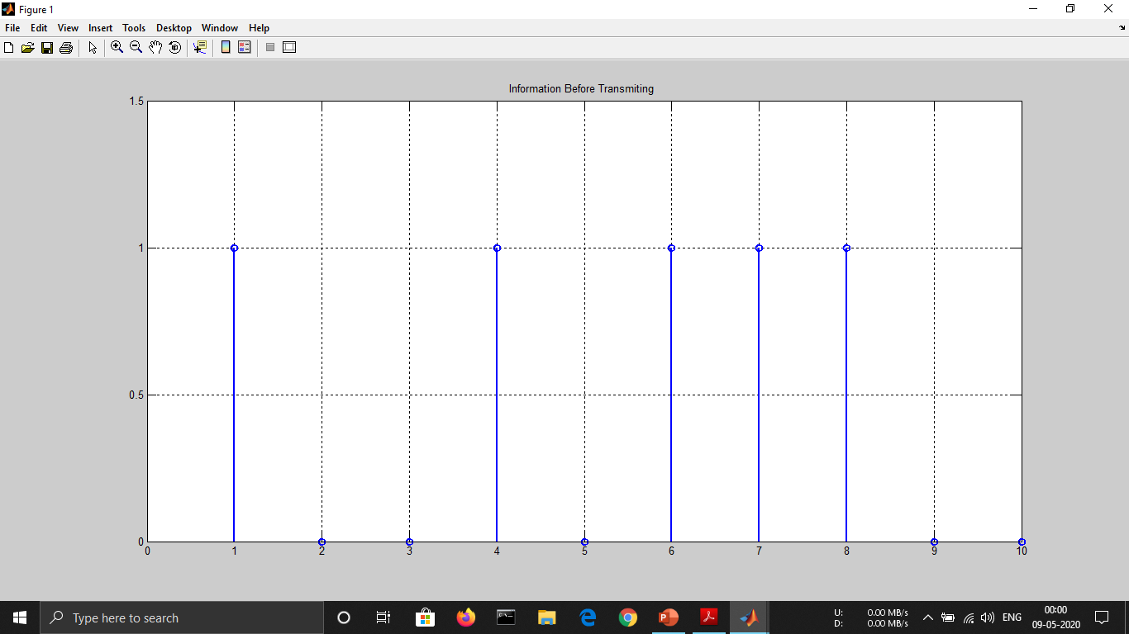

Slide 7
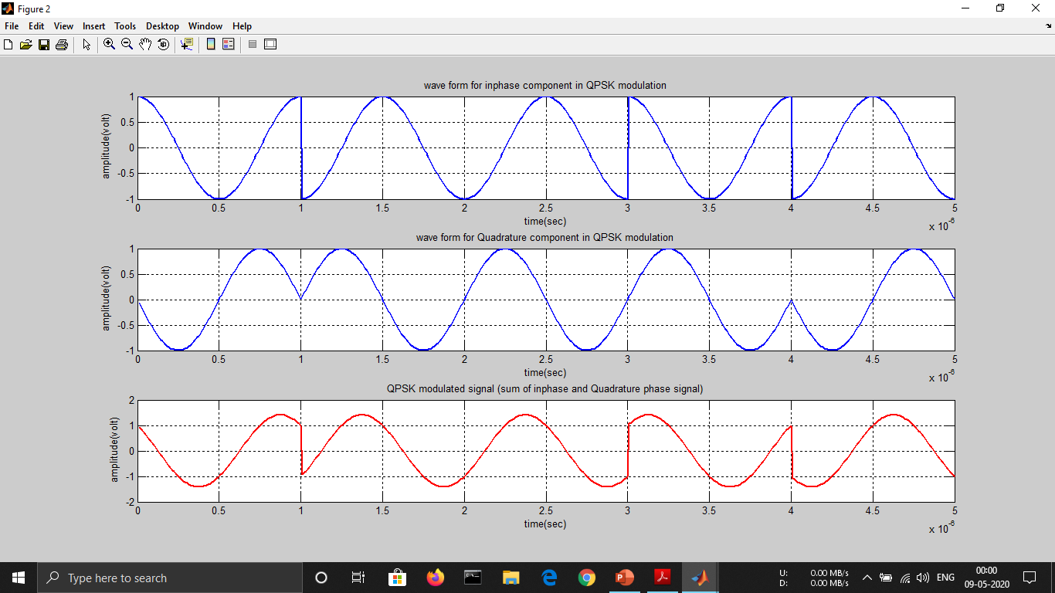

Slide 8
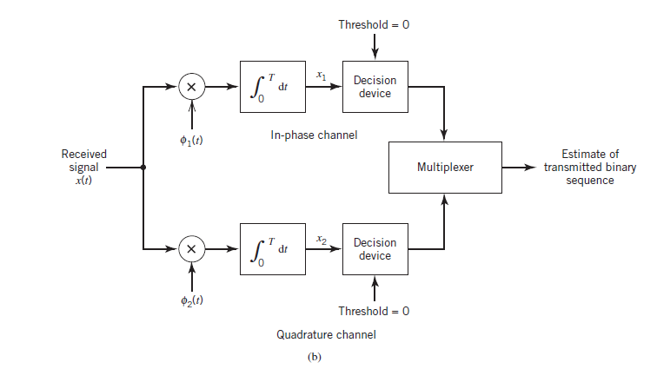
QPSK Demodulation

Slide 9
Continuation…
Pair of correlators, which have a common input x(t). The two correlators are supplied with a pair of locally generated orthonormal basis functions, which means that the receiver is synchronized with the transmitter. The correlator outputs, produced in response to the received signal x(t), are denoted by x1 and x2, respectively.
Pair of decision devices, which act on the correlator outputs x1 and x2 by comparing each one with a zero-threshold.
If x1 > 0, a decision is made in favor of symbol 1 for the in-phase channel output. On the other hand, if x1 < 0, then a decision is made in favor of symbol 0. Similar binary decisions are made for the quadrature channel.
Multiplexer, the function of which is to combine the two binary sequences produced by the pair of decision devices. The resulting binary sequence so produced provides an estimate of the original binary sequence.

Slide 10
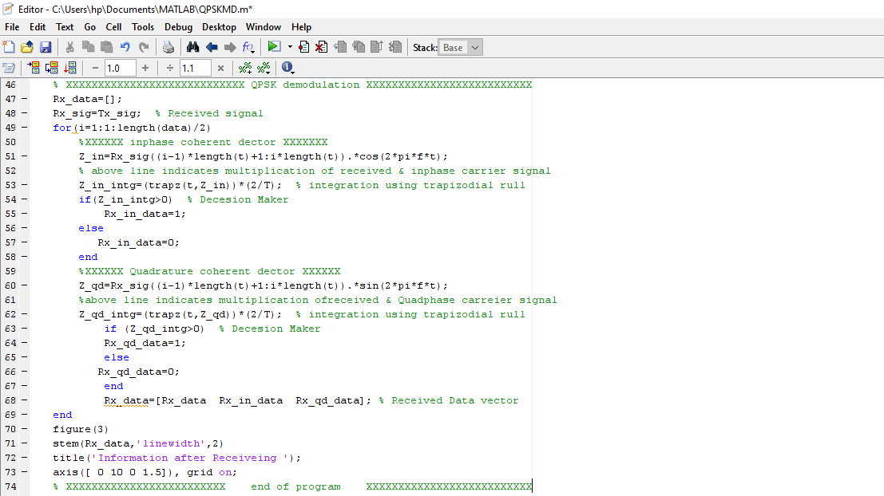

Slide 11


Slide 12
Advantages
Very good noise immunity.
For the same bit error rate, the bandwidth required by QPSK is reduced to half as compared to BPSK.
Because of reduced bandwidth, the information transmission rate of QPSK is higher.
Variation in OQPSK amplitude is not much .Hence carrier power almost remains constant.
Baud rate is half the bit rate therefore more effective utilization of the available bandwidth of the transmission channel.
Low error probability.

Slide 13
Disadvantages
QPSK is not more power efficient modulation technique compare to other modulation types as more power is required to transmit two bits
QPSK is more complex compared to BPSK receiver due to four states needed to recover binary data information
Applications
Satellite transmission of MPEG2 video
Cable modems
Videoconferencing
Cellular phone system
Other forms of digital communication over an RF carrier

